Slide 1
Software Name:LMMS
Presenter: Shivam Bhatt(92301733046)

Slide 2
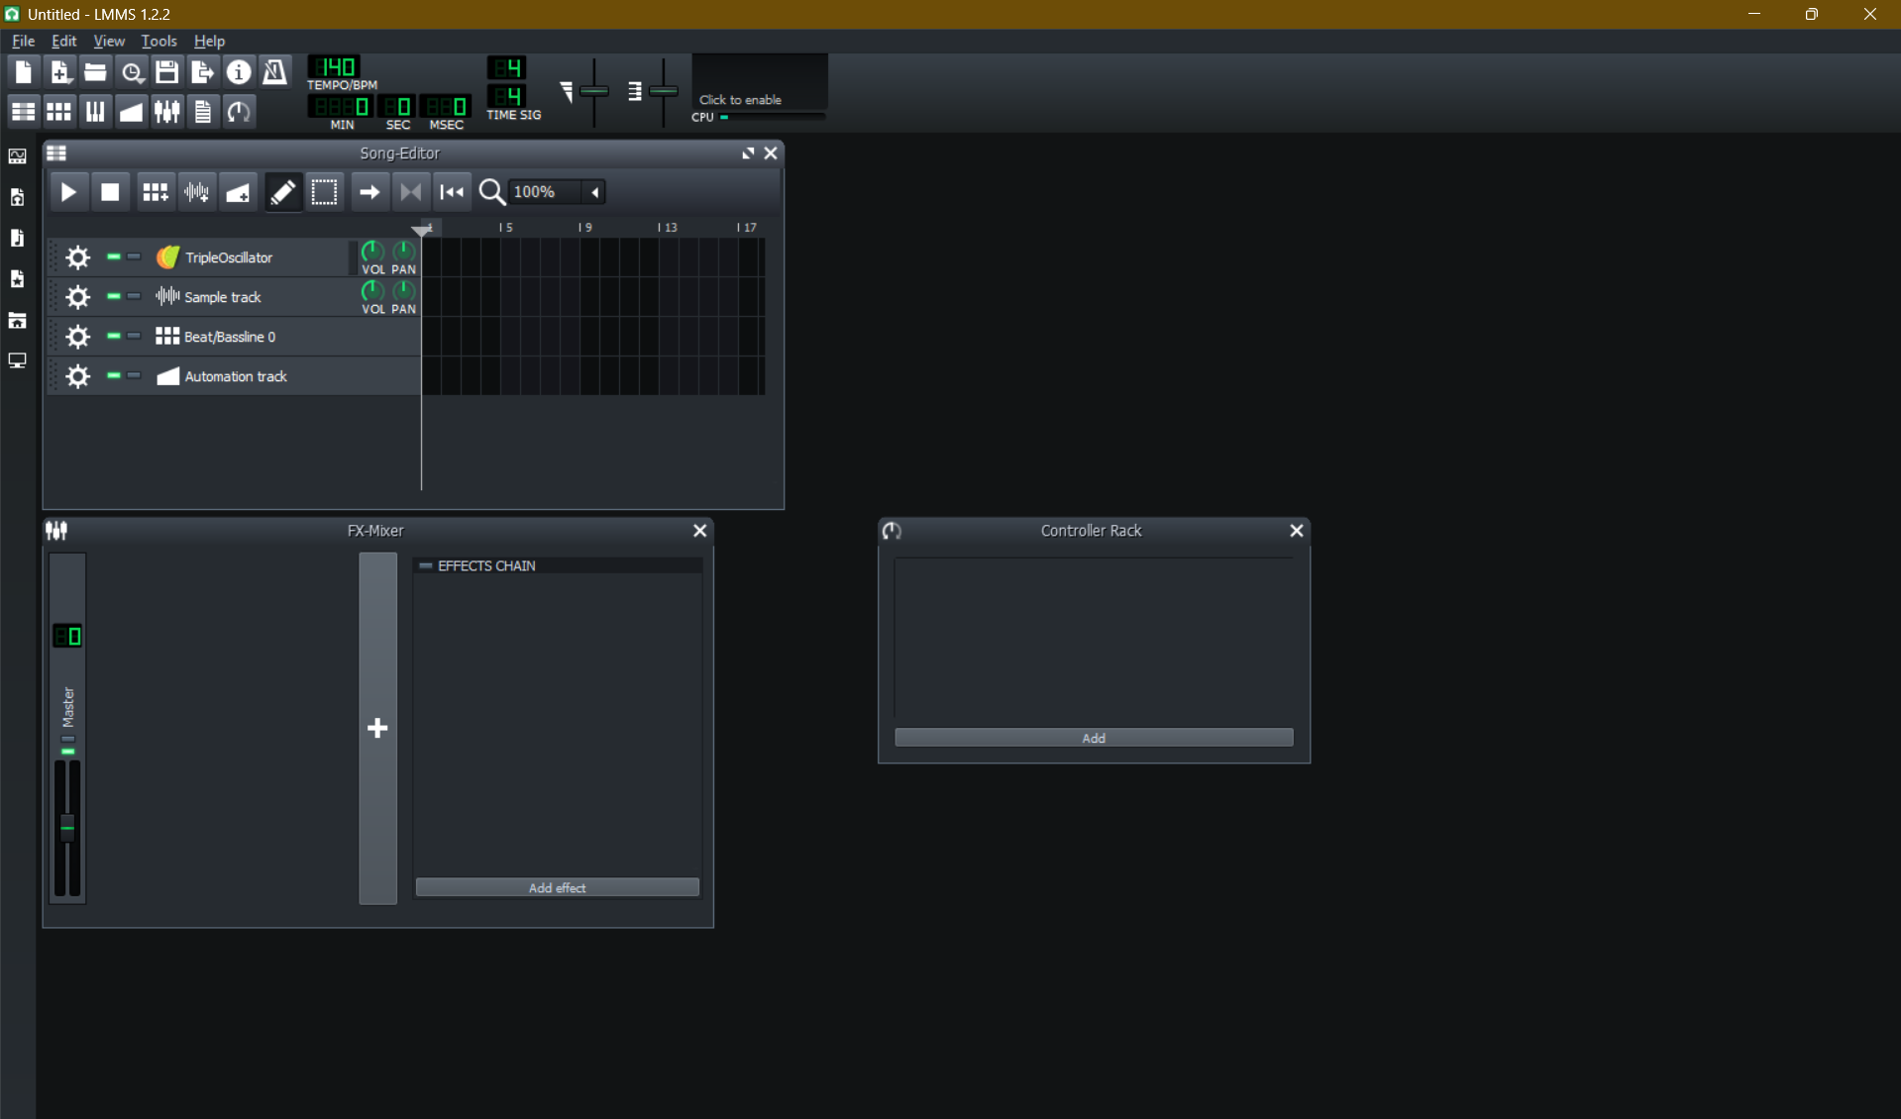
Homescreen

Slide 3
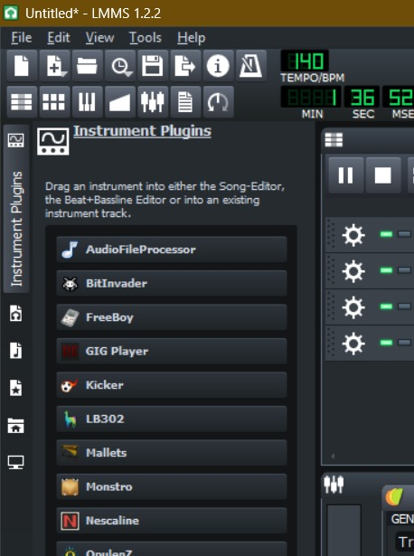
Plugin

Slide 4
Experimental Task 1:Basic Oscillator (Sine Wave Generator)
Steps:
Open LMMS and go to Instrument Plugins.
Add a new plugin (e.g., Triple Oscillator) to your project.
Open the plugin window → set waveform to Sine.
Adjust frequency using pitch control knob.
Change amplitude using volume slider.
Play notes using the on-screen piano or connected MIDI keyboard.
Observe real-time sine wave generation in LMMS.

Slide 5
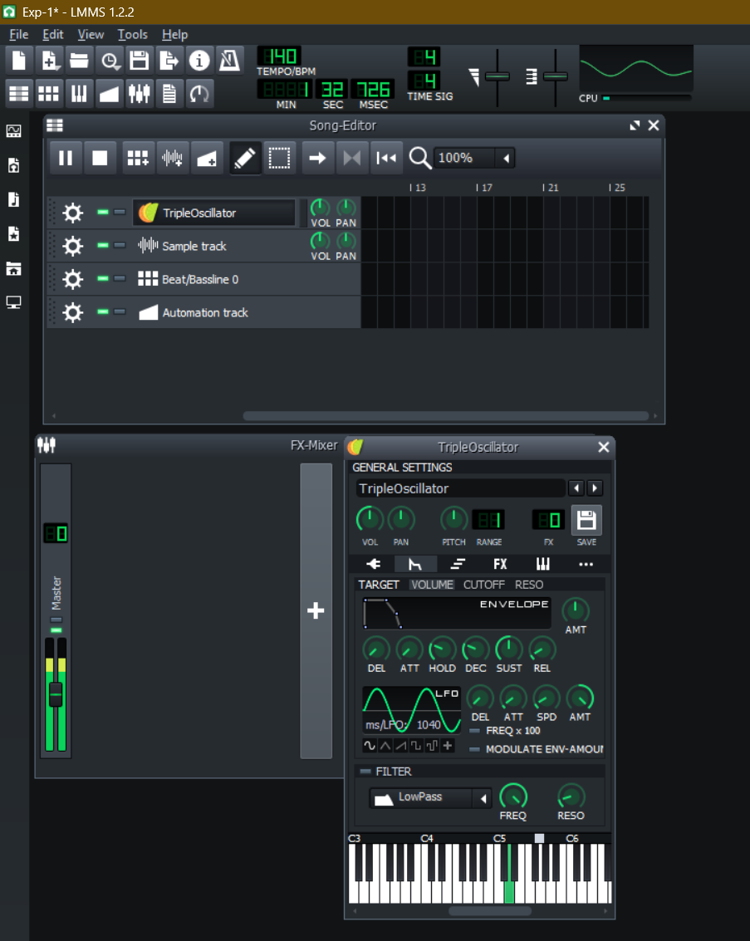

Slide 6
Experimental Task 2:
Steps:
Use the oscillator plugin from Experiment 1 as sound source.
Go to Effect Plugins in LMMS and choose LADSPA Filters → Low-Pass Filter.
Connect the oscillator plugin output → filter input.
Open filter GUI and adjust Cutoff Frequency.
Play the oscillator sound and lower the cutoff to remove high frequencies.
Adjust Resonance knob to emphasize cutoff edge.

Slide 7
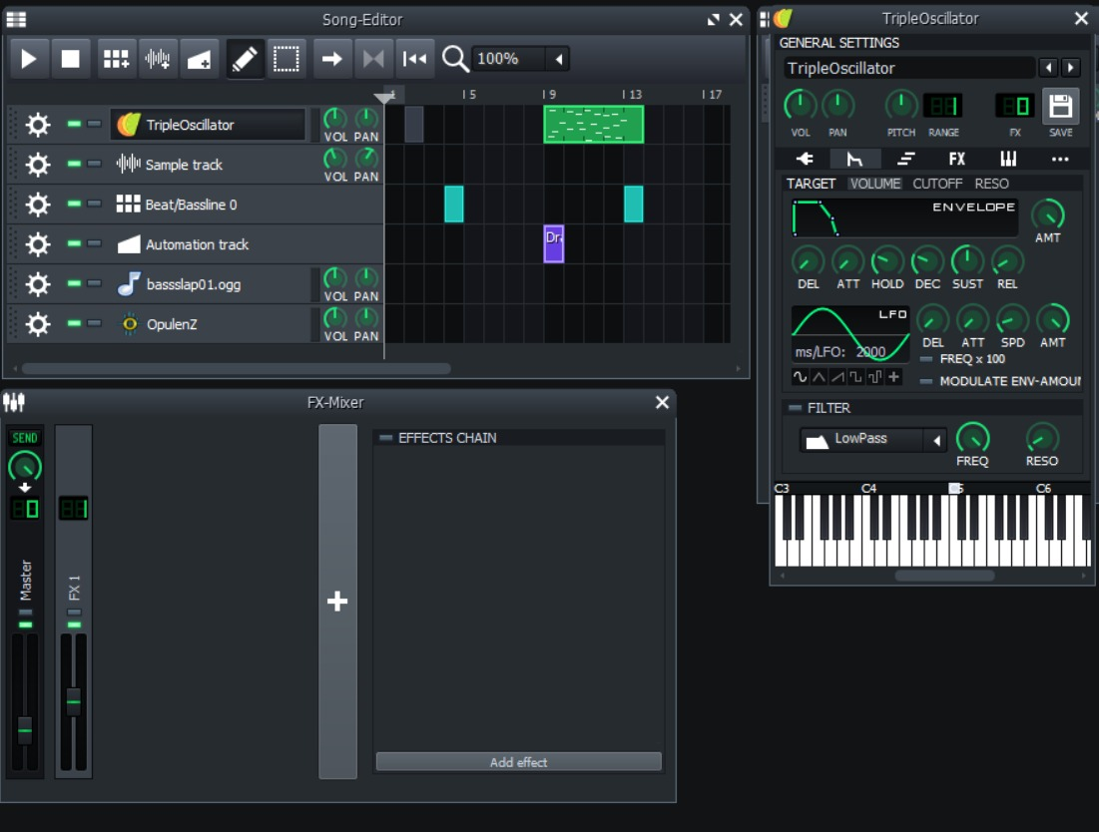

Slide 8
